Slide 1
Python: Function Basics
Lesson 6

Slide 2
Review of Last Lessons

Slide 3
What will be displayed by this program?
str = “Python Programming” print(str[7:])
Programming
Python
Python Programming
PPm
Answer: A - Programming

Slide 4
What will be displayed by this program?
num1 = 4 num2 = 9 num3 = 18 // num1 print(num2 - num3 + num1)
9
13
8
17
Answer: A -9

Slide 5
What will be displayed by this program?
num1 = 5 num1 += 4 print(num1)
4
1
9
6
Answer: C - 9

Slide 6
What will be displayed by this program?
Answer: 10001
Convert the decimal number 17 into decimal.
Convert the binary number 100101 into decimal.
Answer: 37

Slide 7
What will be displayed by this program?
What will be displayed by this program?
num1 = 6
num2 = 9
if (num1 > num2):
print(“Greater than”)
False
True
Greater than
Nothing will be displayed
Answer: C - Greater than

Slide 8
Functions

Slide 9
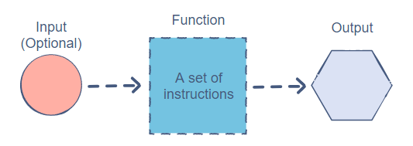
What are functions?
A function is a reusable set of operations.
Think about the print() and len() statements. They always do the same thing - print() displays a message, and len() gives the length of a string or list. They are 2 examples of functions.
Functions can take in an input, perform some instructions, and give an output in return. Sometimes an input isn’t needed, the function does it on its own.

Slide 10
Why use functions?
Functions are important because once it is written, it doesn’t need to be re-written. The 2 benefits of using functions are:
Reusability. A function can be used over and over again. For example, if you make a function, you don’t have to write the code for it again; instead, you can just call the function.
Simplicity. Functions are easy to use and make code much more readable.

Slide 11
Example Function
Say we want to find the smaller number between 2 integers. The code would go like this:
num1 = 40 num2 = 60 if num1 < num2: minimum = num1 else: minimum = num2 print(minimum)
Normally, you would have to repeat this code any time you wanted to check which number was smaller.
However, with functions, you only have to write this code once - any other time you want to use this same code, you will just need to write 1 line to call the function.

Slide 12
Types of Functions in Python
For the previous problem, there is already a function built into Python called min(). It is used like so:
min(10, 100, 40, 1)- This would output 1, as 1 is the minimum value of all of them. It can also take more than 4 values - it can take any number of inputs above 2.
Just writing min() is much easier than writing that big block of code from before, which is why functions are so extremely useful.
There are 2 main types of functions in Python: built-in functions (like the min function), and user-defined functions, which the user creates by themself.

Slide 13
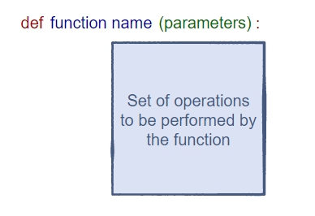
Components of a Function
A function is made by using the def keyword and in the following format:
The function name is just a name used to identify the function, and the parameters are the inputs of the function, which can be used within the function. (Parameters are optional)
The body contains the set of operations the function will perform. It is indented 1 space to the right.

Slide 14
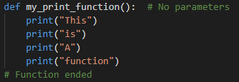
Creating a basic function
As an example, we will make a function that prints 4 lines of text: This, is, a, function. It looks like this:
And to call the function (to use it in code), you just need to type one line:

Slide 15

Parameters
Parameters are the way of passing data into the function, which can be used in many different ways. An example of a parameter being used in a function is as so:
And it would be called like this:
This is a basic form of the minimum function that takes in 2 values. In this case, the first value is 20, and the second value is 10. The variables first and second only work in that function, and in this case, they have the value 20 and 10, respectively.
A parameter can be any datatype, from an integer to a list.
The parameters are in the parentheses

Slide 16

Return
Functions can also return values, like len(). It takes in a string or list, and returns a number. To show how this works, we will use the same example as before, but instead of printing the minimum, we will return it.
The returned value can be stored in a variable or printed out later. The benefit of using return is that the output can then be used for something else, instead of just being displayed.

Slide 17
Practice Questions

Slide 18
Which line of code could be used to call the following function?
def example_function(): print(“Hello World!”) print(“This is a function.”)
example_function
def example_function()
example_function()
def example_function
Answer: C - example_function()

Slide 19
Which line of code could be used to call the following function?
def example_function(num1, num2): num1 += 1 print(num1 * num2)
example_function(10, 20)
def example_function()
example_function()
example_function(10)
Answer: A - example_function(10, 20)

Slide 20

Which line of the code is where the parameters are?
You can see the line of code by looking at the left edge of the screenshot.
Line 1
Line 2
Line 3
Line 5
Answer: A - Line 1

Slide 21
Which line of the code is where the return is?
You can see the line of code by looking at the left edge of the screenshot.
Line 1
Line 2
Line 3
Line 5
Answer: C - Line 3

Slide 22
Which line of the code is where the function call is?
You can see the line of code by looking at the left edge of the screenshot.
Line 1
Line 2
Line 3
Line 5
Answer: D - Line 5

Slide 23
Which lines of the code are the function body?
Pick 2 answers.
Line 1
Line 2
Line 3
Line 5
Answer: B & C - Lines 2-3

Slide 24
Making Sample Functions

Slide 25
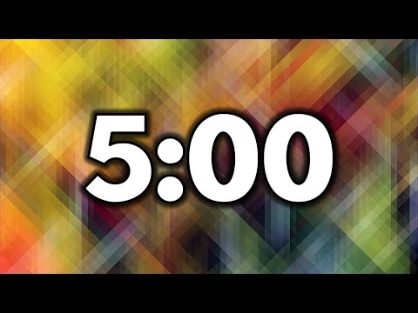
Example function #1
Make a function that takes in a string (representing a name), and then prints out “Hello [name]!” Here is an example of how a call to it would look:
example_function_1(“Bob”)
would print out
Hello, Bob!
Bonus: If you have time, try to make a program that takes in 2 names, and prints out:
Hey [name1], meet [name2]!

Slide 26
Example function #2
Make a function that takes in 3 numbers, and returns the product (multiplication) of all the numbers. For example:
value = example_function_2(2, 3, 5) print(value)
would print out
30
Tip: To do this, you can first multiply the first 2 numbers. Then, multiply that product with the third number. Also, remember to use return.

Slide 27
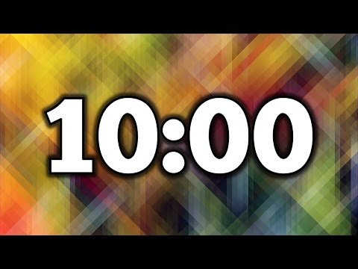
Example function #3
Make a function that takes in a list of numbers, multiplies each number in the list by 2, and returns that list. For example,
value = example_function_2([2,3,4,5]) print(value)
would print out the list
[4,6,8,10]
Tip: Remember to use a for loop for this to go through each value in the list and double it.

